Slide 1
Architecting a Modern Data Platform July 28-30, 2020

Slide 2

Facilitator
Dan Sutherland
Distinguished Engineer & CTO - Data Platforms, Solution/Data Architect, 2xAWS Certified, Azure Certified, GBS

Slide 3
Data Architecture 101
3
21 August 2020
IBM Services
© 2019 IBM Corporation

Slide 4
What is data architecture?
Data architecture describes how data is collected, stored, transformed, distributed, and consumed. - Source: Wikipedia
Data architecture is a big umbrella term that encapsulates data storage, computational resources, and everything in between. All the technology that supports the collection, processing, and dashboarding of data is included in the architecture.
However, data architecture doesn’t just include objects; it also includes the operational discipline surrounding data usage and compliance. Data architects can be said to act as data physicians, diagnosing both the physical maladies in the data pipeline and the organizational habits that are detrimental to the health of the system.
- Source: Dataiku

Slide 5
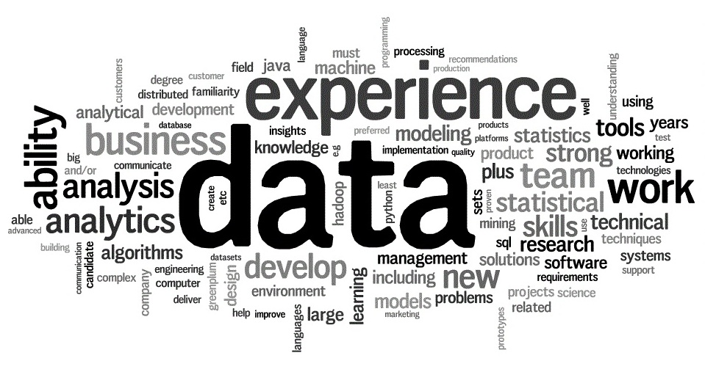
Why do you need it?
“In the race to win customers and market share, data-driven organizations are increasing the distance between them and their less-informed peers. McKinsey Global Institute reports that data-driven organizations are now 23 times more likely to acquire customers, 6 times as likely to retain customers, and 19 times as likely to be profitable as a result.”
As a result:
Innovative tools are used to manage the large volume of data across the organization
Design patterns and leading practices for data architecture are well established and followed by the enterprise
Data flows across the enterprise application architecture are documented, understood and available for use
An enterprise-wide data model exists and is leveraged for new projects and applications
A robust data architecture enables increased flexibility, speed and agility of the enterprise

Slide 6
Data Architecture 101 – Functional Elements
Cognitive Business Decision Support
6
21 August 2020
© 2020 IBM Corporation

Slide 7
Data Architecture 101 – Data Types
Cognitive Business Decision Support
7
21 August 2020
© 2020 IBM Corporation

Slide 8
Data Architecture 101 – NFRs
Data Sizes system has to handle:
Small : 5M parties, 6M accounts, 50M counterparties and 450M transactions/month
Medium : 15M parties, 25M accounts, 150M counterparties and 1.5B transactions/month
Large : 33M parties, 40M accounts, 330M counterparties and 3B transactions/month
Extra-large (consortium) : 90 M parties, 150M accounts, 900M counterparties, 85B transactions/month
End-to-end security of data both in motion and in rest.
Near real-time analytics response. From RegTech perspective, customers have asked for on-demand scoring of transactions with sub-second response times (200 milliseconds). Execute a set of rules and models.

Slide 9
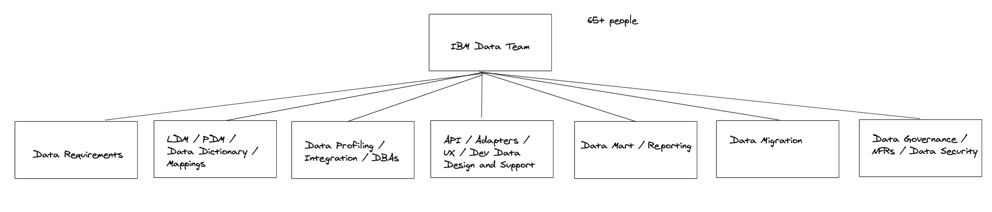
Case Study – A Day in the Life (Data Team & Responsibilities)

Slide 10
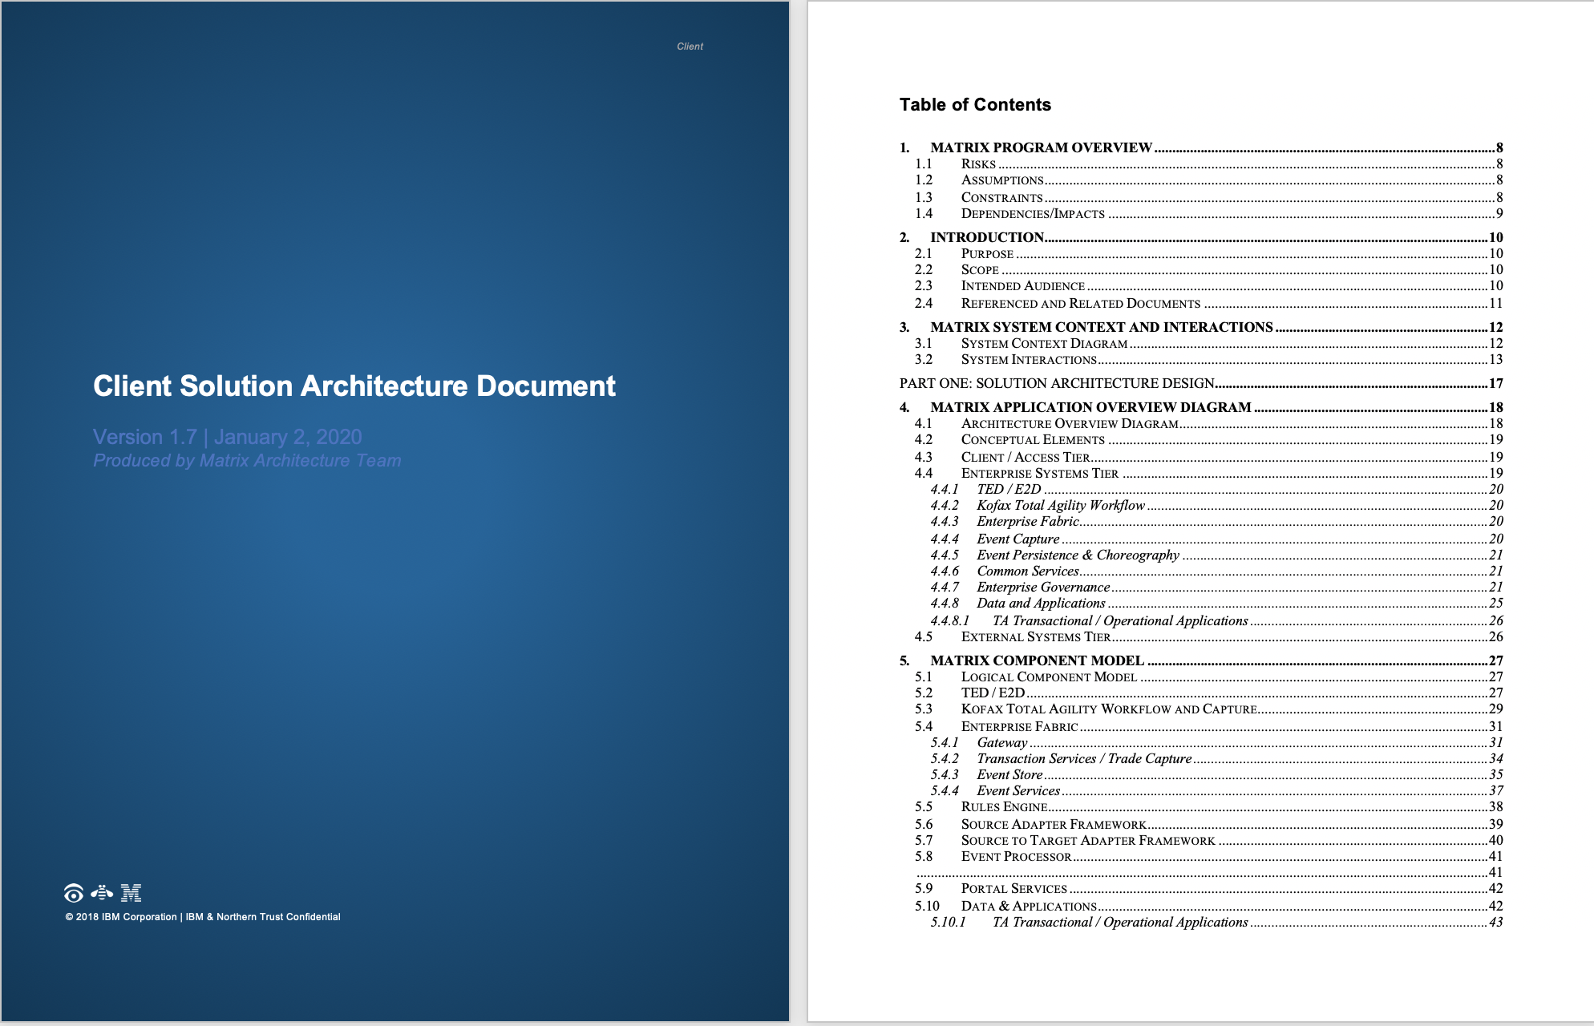
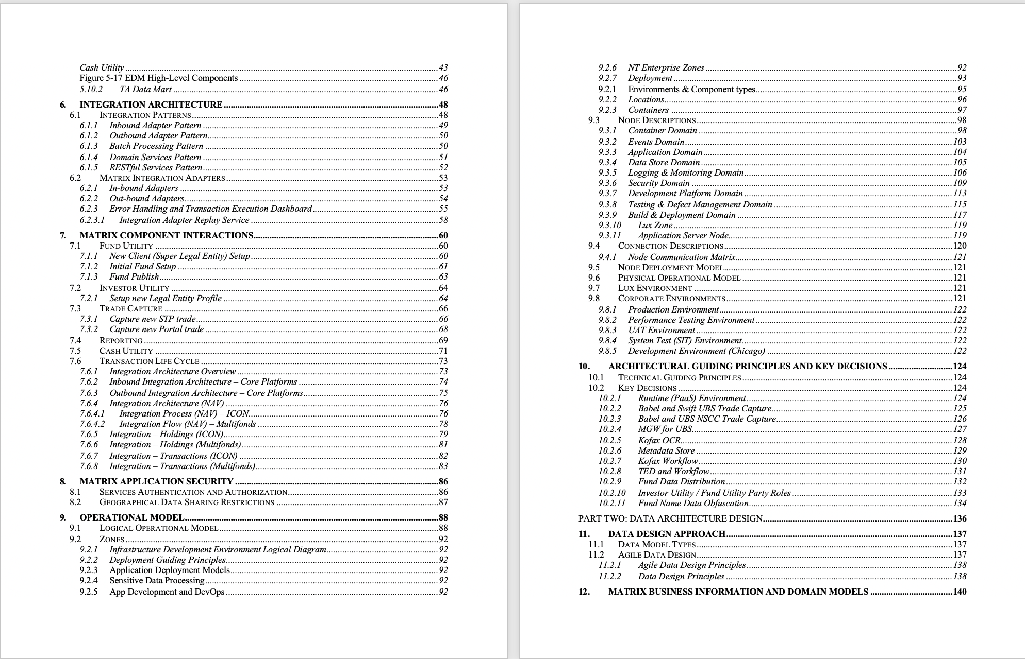
Case Study Client Data Architecture Deliverable ToC – Part 1

Slide 11
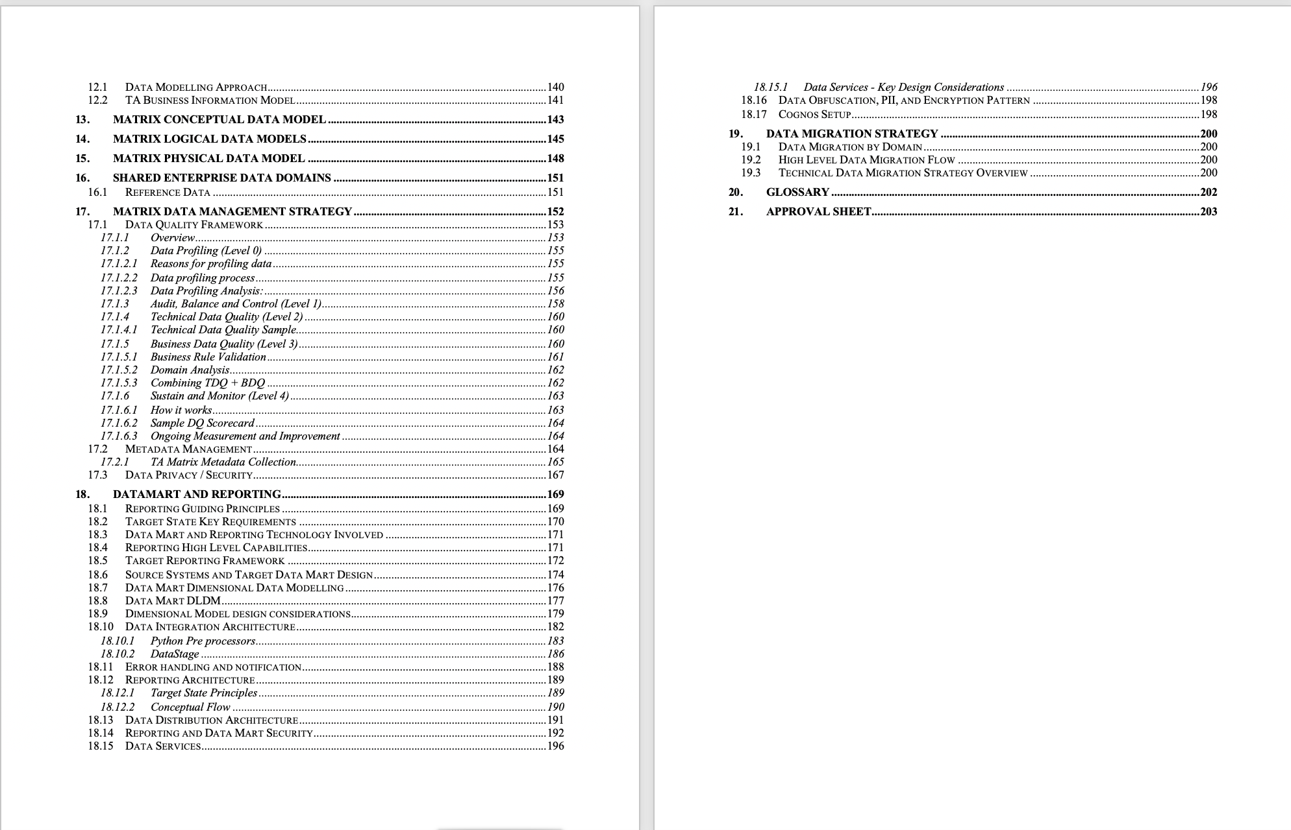
Case Study Client Data Architecture Deliverable ToC – Part 2

Slide 12
Group Lab #2 – Familiarize w/IAM
IAM - https://www.qwiklabs.com/focuses/10408
Notes:
20 minutes
Student could stop after testing the first user's access

Slide 13
Q&A

